Slide 1
ATAI
Advanced Techniqueof Artificial Intelligence
ATAI
ChongqingUniversity _{AdvancedTechniqueof}
of Technology Artificial Intelligence
Chongqing University of
Technology
Chongqing University ^{ATAI}
_{of Technology} Advanced Techniqueof
Artificial Intelligence
Chongqing University of Technology
Chongqing University of Technology
CARAT: Contrastive Feature Reconstruction and Aggregation for Multi-modal Multi-label Emotion Recognition
CARAT: Contrastive Feature Reconstruction and Aggregation for Multi-modal Multi-label Emotion Recognition
Code:https://github.com/chengzju/CARAT
—— AAAI 2024
Reported by Tingting Zhang
1

Slide 2
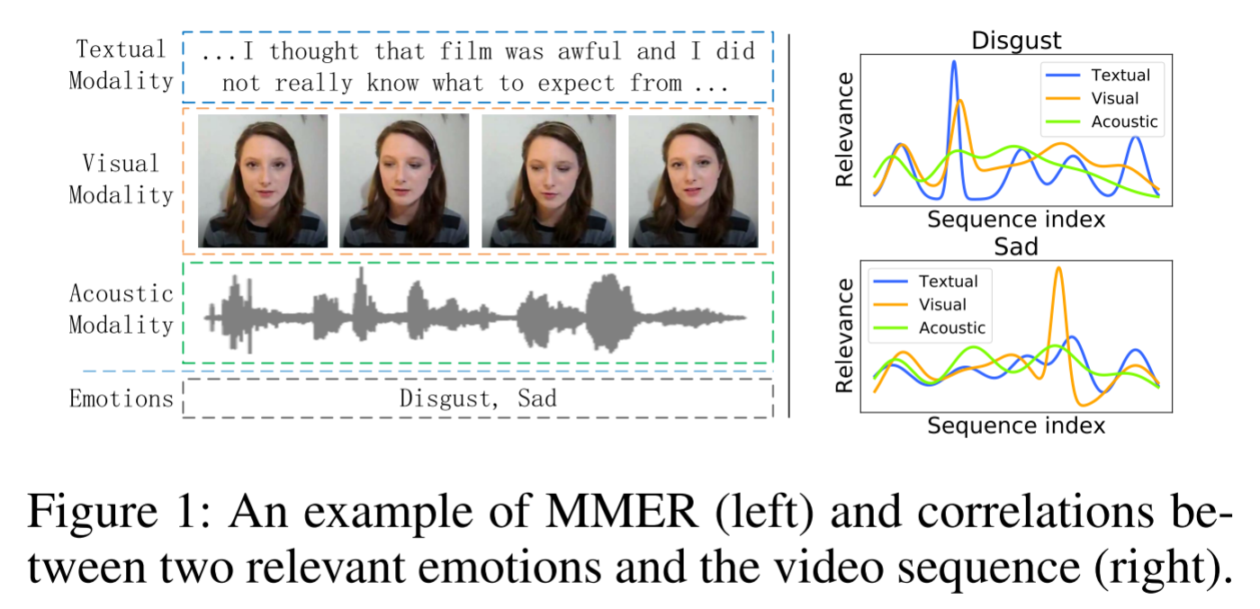
ATAI
AdvancedTechniqueof
Artificial Intelligence
ATAI
ChongqingUniversity _{AdvancedTechniqueof}
of Technology Artificial Intelligence
ChongqingUniversity of Technology
Motivation
1. A key challenge of MMER is how to effectively represent multi-modal data while maintaining modality specificity and integrating complementary information.
2. Another challenge of MMER is how to effectively model both label-to-label and modality-to-label dependencies.
Notes:
将多个模态统一到一个相同的表示中不可避免地会忽略每个模态的特殊性，从而失去丰富的区分特征。(如何有效地表示多模态数据，同时保持模态特异性和整合互补信息。)
作为一个多标签任务，MMER还需要处理标签之间的复杂依赖关系。
通常，不同的模态具有不一致的情感表达，相反，不同的情感集中在不同的模态上，这意味着推断每个潜在标签在很大程度上取决于不同模态的不同贡献。如图1所示，我们可以更容易地从视觉模态中推断出悲伤，而厌恶可以从文本和视觉模态中预测出来。(因此，MMER的另一个挑战是如何有效地建模标签到标签和模态到标签的依赖性。)

Slide 3
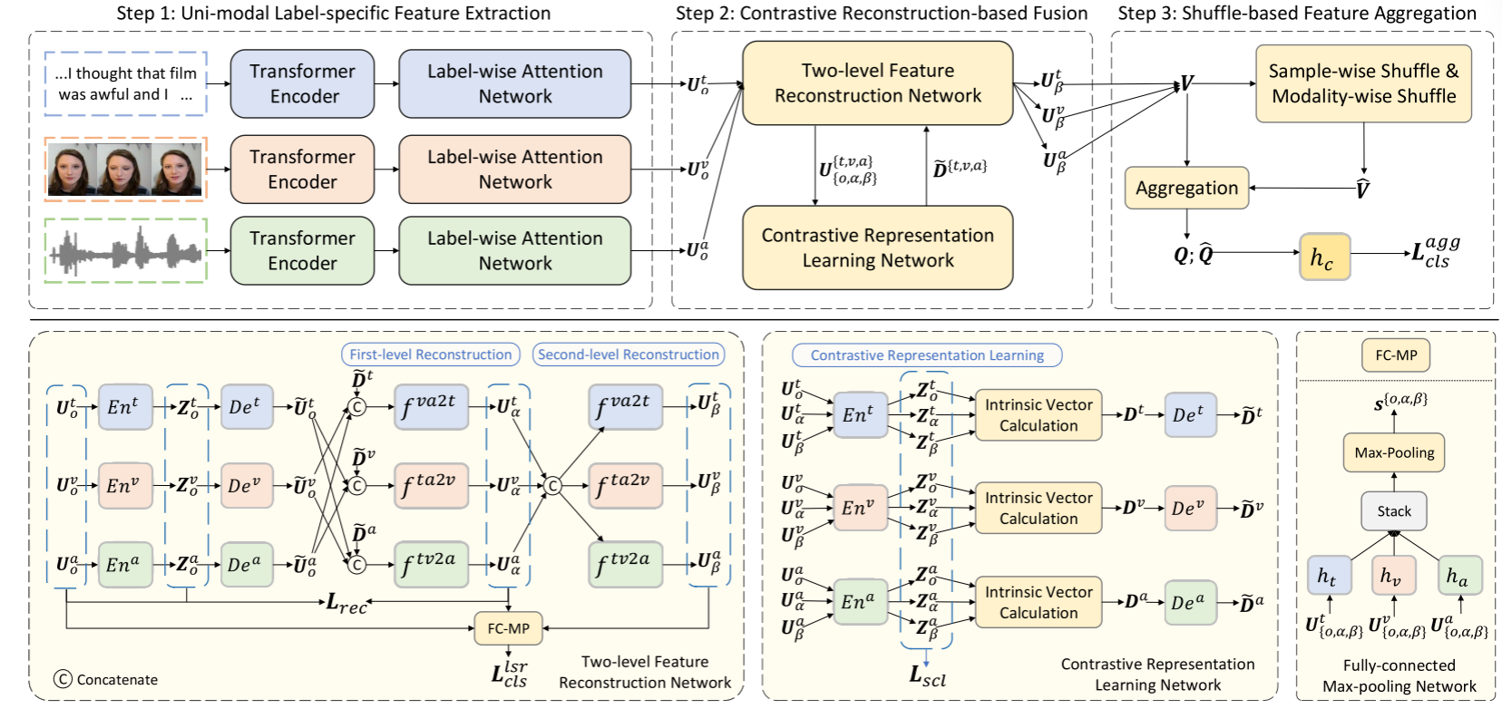
ChongqingUniversity of Technology
ATAI
AdvancedTechniqueof
Artificial Intelligence
ATAI
ChongqingUniversity _{AdvancedTechniqueof}
of Technology Artificial Intelligence
Overview

Slide 4
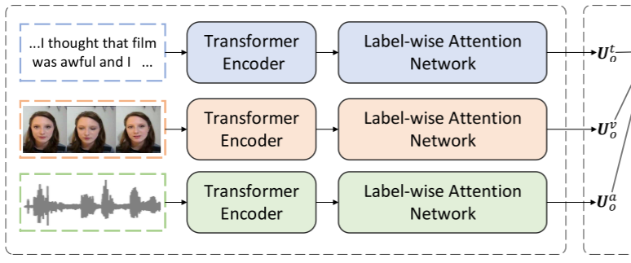
ChongqingUniversity of Technology
ATAI
AdvancedTechniqueof
Artificial Intelligence
ATAI
ChongqingUniversity _{AdvancedTechniqueof}
of Technology Artificial Intelligence
Method
1. Uni-modal Label-specific Feature Extraction.
1) Transformer-based Extractor
2) Multi-label Attention

Slide 5
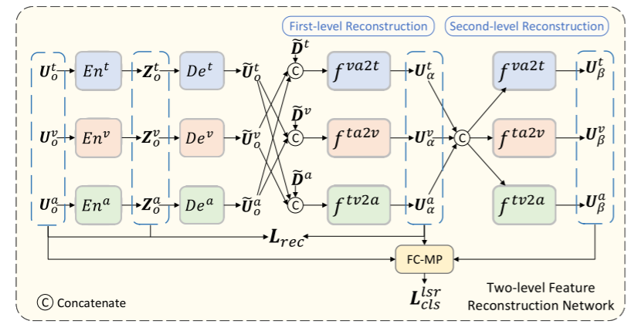
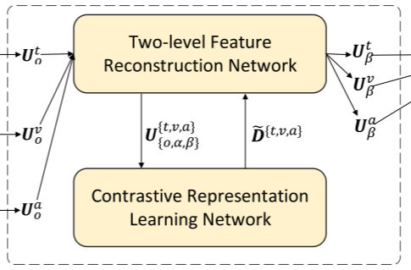
ChongqingUniversity of Technology
ATAI
AdvancedTechniqueof
Artificial Intelligence
ATAI
ChongqingUniversity _{AdvancedTechniqueof}
of Technology Artificial Intelligence
Method
2. Contrastive Reconstruction-based Fusion
1) Multi-modal Feature Reconstruction.

Slide 6
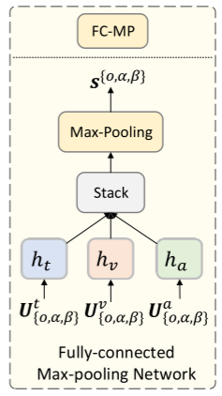
ChongqingUniversity of Technology
ATAI
AdvancedTechniqueof
Artificial Intelligence
ATAI
ChongqingUniversity _{AdvancedTechniqueof}
of Technology Artificial Intelligence
Method
2. Contrastive Reconstruction-based Fusion
1) Multi-modal Feature Reconstruction.

Slide 7
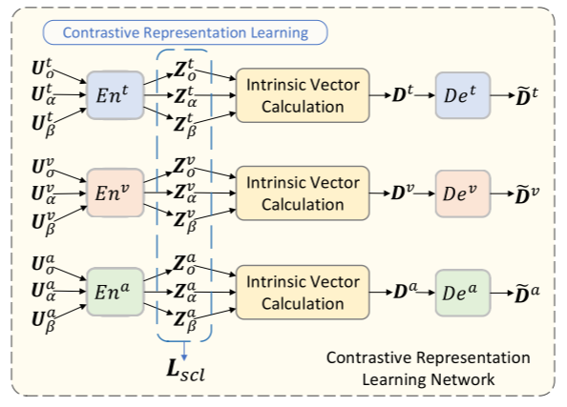
ChongqingUniversity of Technology
ATAI
AdvancedTechniqueof
Artificial Intelligence
ATAI
ChongqingUniversity _{AdvancedTechniqueof}
of Technology Artificial Intelligence
Method
2. Contrastive Reconstruction-based Fusion
2) Contrastive Representation Learning.

Slide 8
ChongqingUniversity of Technology
ATAI
AdvancedTechniqueof
Artificial Intelligence
ATAI
ChongqingUniversity _{AdvancedTechniqueof}
of Technology Artificial Intelligence
Method
3. Shuffle-based Feature Aggregation

Slide 9
ChongqingUniversity of Technology
ATAI
AdvancedTechniqueof
Artificial Intelligence
ATAI
ChongqingUniversity _{AdvancedTechniqueof}
of Technology Artificial Intelligence
Method
3. Shuffle-based Feature Aggregation

Slide 10
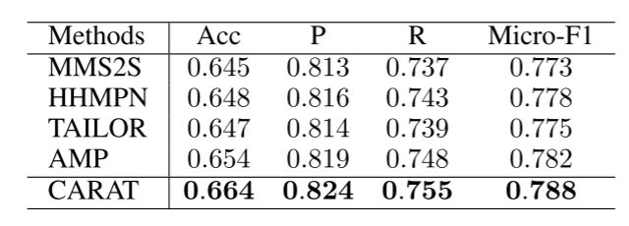
ATAI
AdvancedTechniqueof
Artificial Intelligence
ATAI
ChongqingUniversity _{AdvancedTechniqueof}
of Technology Artificial Intelligence
ChongqingUniversity of Technology
Experiments

Slide 11
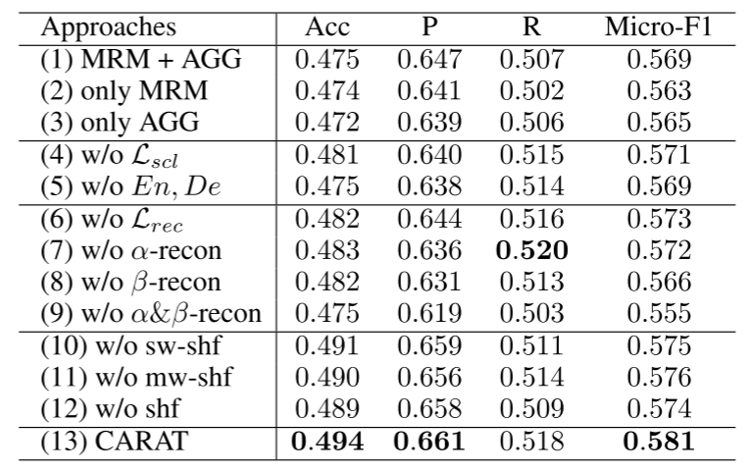
ATAI
AdvancedTechniqueof
Artificial Intelligence
ATAI
ChongqingUniversity _{AdvancedTechniqueof}
of Technology Artificial Intelligence
ChongqingUniversity of Technology
Experiments

Slide 12
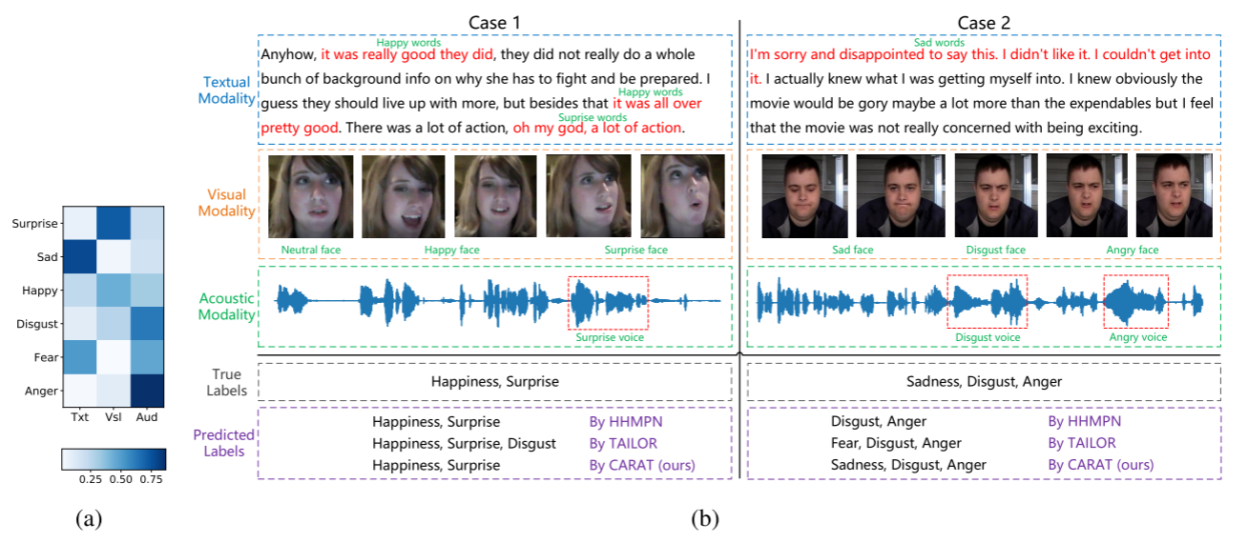
ATAI
AdvancedTechniqueof
Artificial Intelligence
ATAI
ChongqingUniversity _{AdvancedTechniqueof}
of Technology Artificial Intelligence
ChongqingUniversity of Technology
Experiments

Slide 13
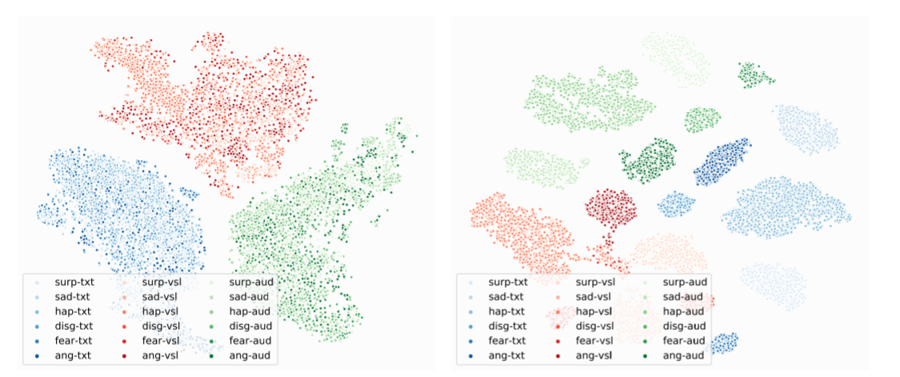
ATAI
AdvancedTechniqueof
Artificial Intelligence
ATAI
ChongqingUniversity _{AdvancedTechniqueof}
of Technology Artificial Intelligence
ChongqingUniversity of Technology
Experiments

Slide 14
ChongqingUniversity of Technology
ATAI
AdvancedTechniqueof
Artificial Intelligence
ATAI
ChongqingUniversity _{AdvancedTechniqueof}
of Technology Artificial Intelligence
Thanks!

